Slide 1
Restaurant Billing Software
Only one way to go
is in Hunger Zone

Slide 2
Content(1)
Introduction
DFD ( Data Flow Diagram )
Work Flow
Proposed Software
Feature of software
Technology & tools used
Objective of the Billing Software

Slide 3
Content(2)
Need of new software
Benefit
Limitation
Interface
Hardware and software requirement
Conclusion

Slide 4
Introduction
Restaurants are the places where the customers come to spend some of their time and eat & drink something. So to make their ordering faster and easier we Introduced “Restaurant Billing Software”.
The project is “Restaurant Billing Software” for monitoring and controlling the transactions in a Restaurant.
Restaurant Billing Software is a windows application designed to help users maintain & organize Restaurant.

Slide 5
Introduction
The sotware is primarily made to reduce manpower in restaurants.
The software processes transaction and stores the resulting data. Reports will be generated from these data which help the manager to make appropriate business decisions for the restaurant.

Slide 6
Data Flow Diagram
Database
Customer
Requests for order
Data is saved
Data is retrieved
Gets the ordered item and bill
Software
Requests Data of a customer with unique ID
Administrator
Data is given to the user

Slide 7
Work Flow
Work Flow in the restaurant will be done in the following way : -
The data entry operator will login to the software.
Then waiter will come to the customer, takes his order.
Data entry operator will enter the order of the customer.
Then, the software automatically calculates the bill and generate the bill of the entered order details.
The waiter will takes the order to the customer.
Waiter will give him, his bill.
Customer will pay for his orders.

Slide 8
Proposed software
To overcome all the extra cost being spent on extra men power.
To reduce extra efforts.
To remove the burden of the receptionist of taking order and writing it down by hand, calculating bill, calculating taxes and calculating the total price.
This whole process is done by only software.
Bill is also generated on paper.

Slide 9
List of some features
Provide easy payment mode and overall bill.
Easy way to enter new customers.
Easy to handle and portable
Provide security to customers data
Having “Login” feature allowing only administration and team to make changes.
Automatically Tax calculation.
Ease in handling and faster transaction.

Slide 10
Technology and tools used
Modules in Python: Tkinter, math, time, OS
Python IDLE 3.8.0
Windows OS

Slide 11
Objective of Restaurant Billing Software
Availability : The all transaction of restaurant stored permanently in the database admin can see the data in the availability of any information.
Maintain Cost : Reduce the cost of maintenance. It is stand-able application so no required of cost for maintain it.
Flexibility : The software modifiable dependable on changing needs of the users. It is portable to different computer systems.

Slide 12
Need for Restaurant Billing Software
Simple Menu Setup.
User friendly order managements.
Customer Management.
Better customer service.
Support auto GST calculation feature.

Slide 13
Benefit
Saving in labor due to self-service system.
Faster work is done
Low cost of operation
Easy to re-correct and re-enter newly fresh data
No complexity in customer is data as all gets an unique data

Slide 14
Limitation
Limitations in the software are :-
There is lack of bill deletion once created.
Dependent on Operating system like Windows OS , it requires different coding for other Operating Systems.
Any problem in software make system not working purposefully.

Slide 15
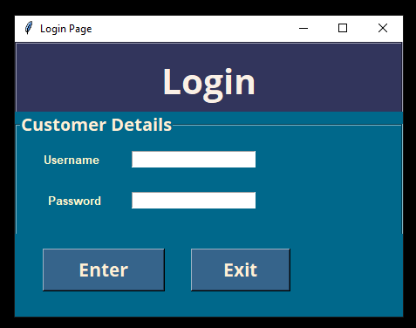
Interface
Login :
Login features allows only access
to admin
When ‘Enter’ is pressed it takes
us/admin to main billing page

Slide 16
Interface
Login :
This also decreases the probability of
un-authorised accessing
This feature makes data safe from unauthorised personals
This features increases security

Slide 17
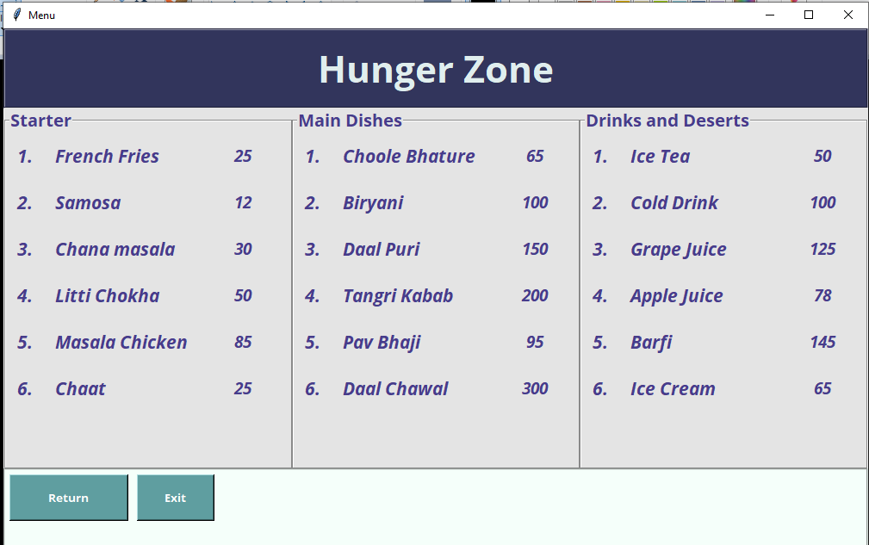
Interface
Menu :

Slide 18
Interface
Menu :
As the name shows that it has all items including theirs prices
Menu feature is to help customers with pricing
This feature has whole dishes and their pricing

Slide 19
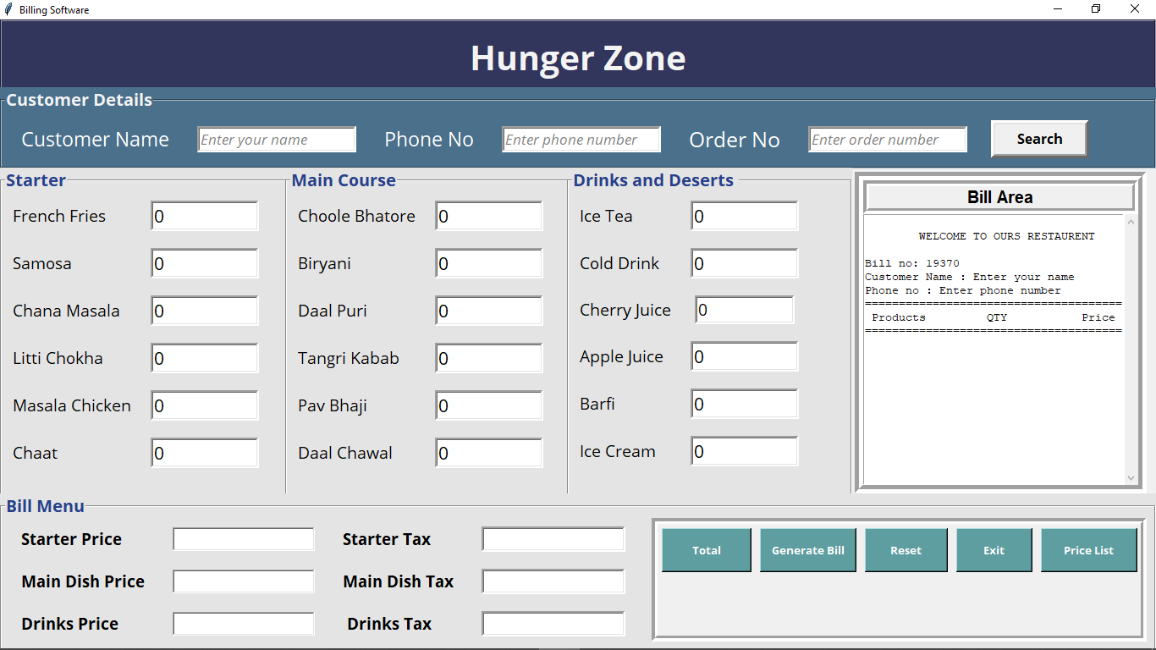
Main Window / Invoice :

Slide 20
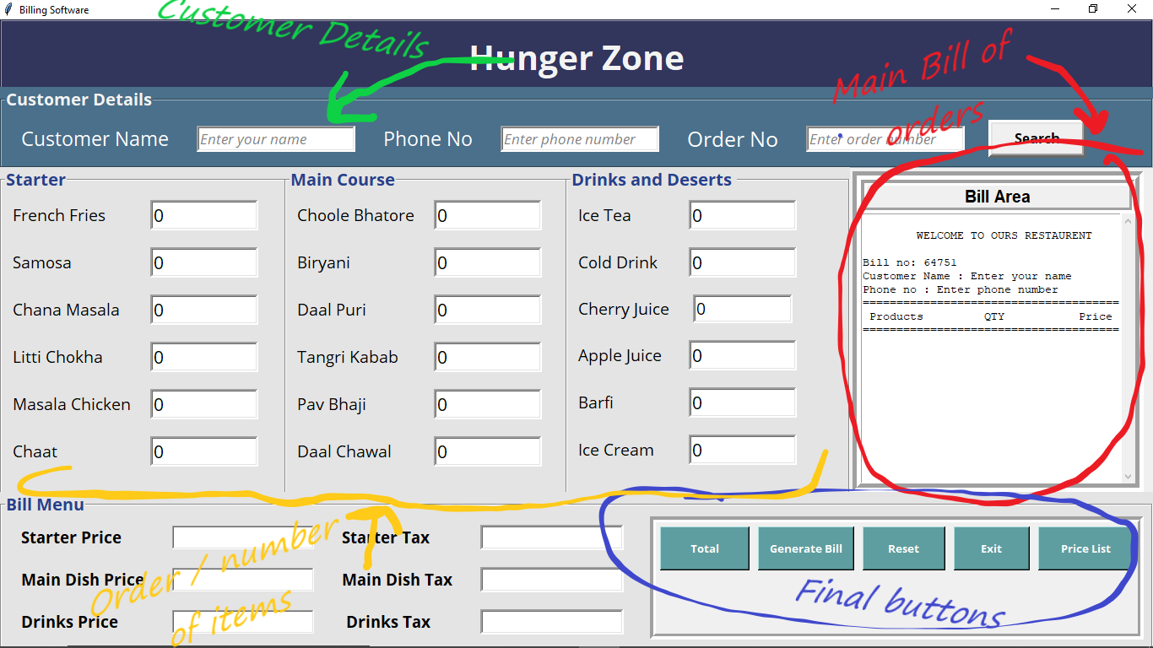
Invoice

Slide 21
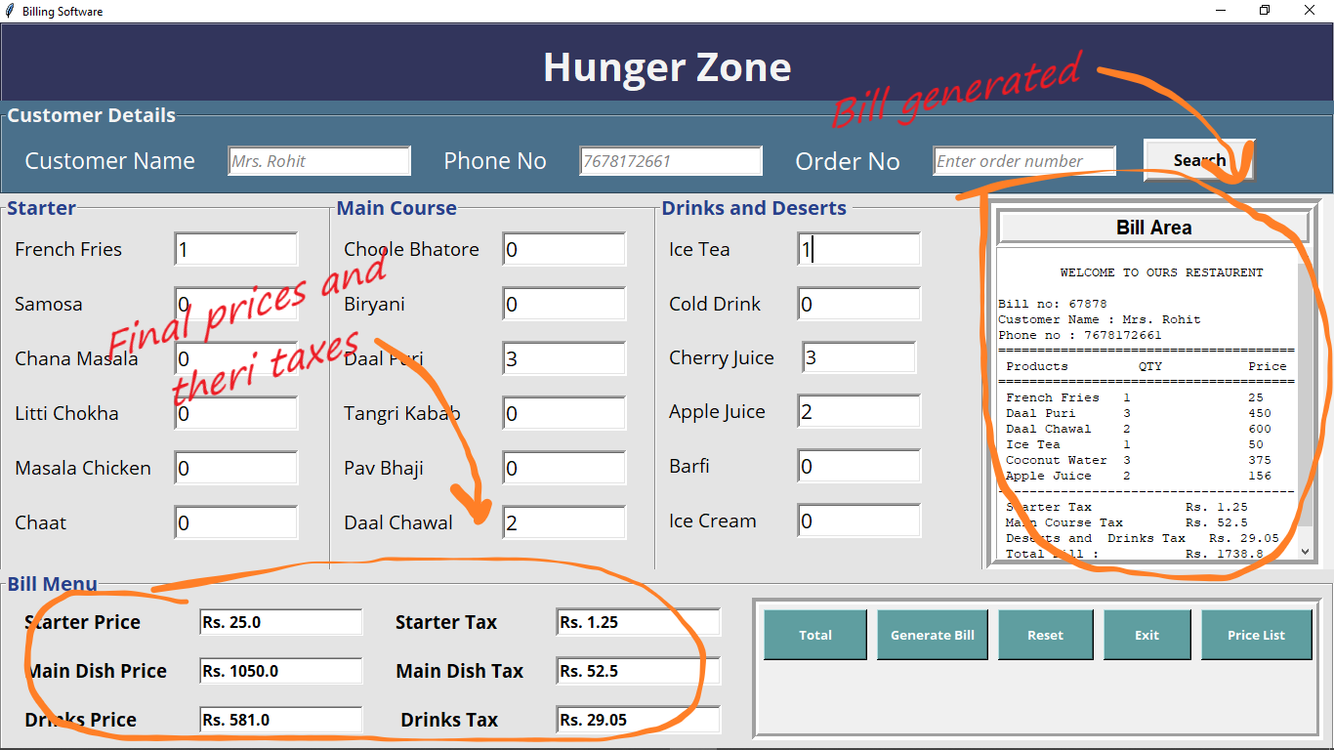
Invoice

Slide 22
Interface
Main Window / Invoice :
In this area, we place customer’s order requests.
Firstly, customers details are filled and then order is placed.
After placing order total prices and taxes on each item is calculated.
Finally, we generate bill or invoice of orders placed.
In main, window we have provided the ‘Price List’ to check price of each item.

Slide 23
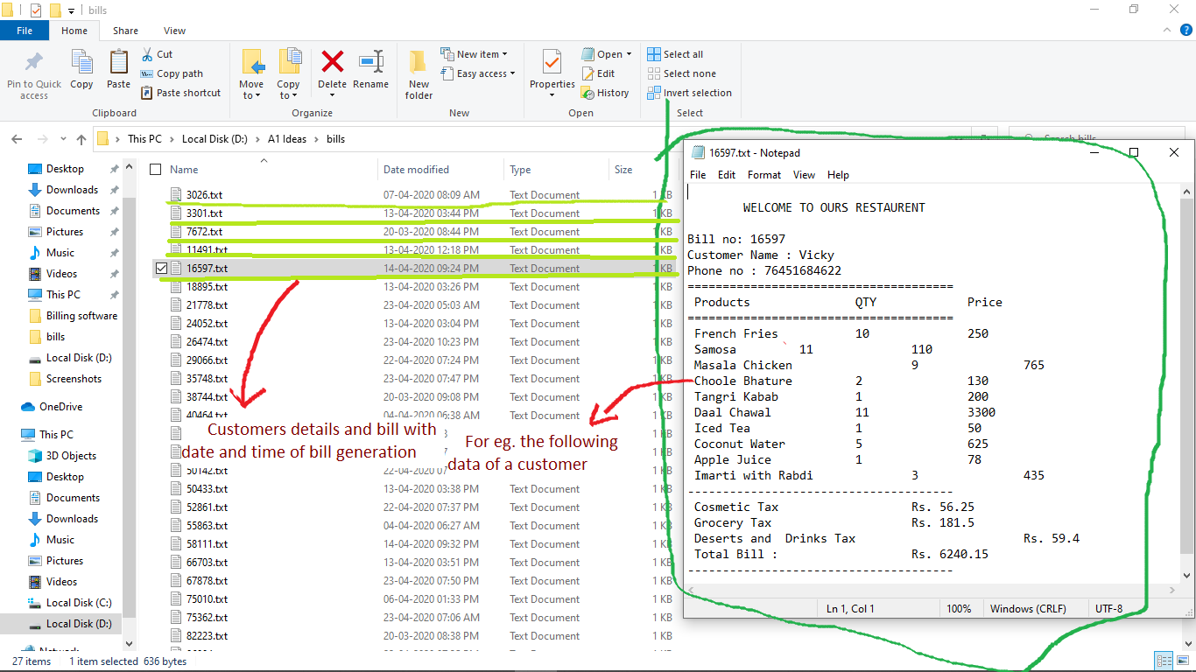
Saved data

Slide 24
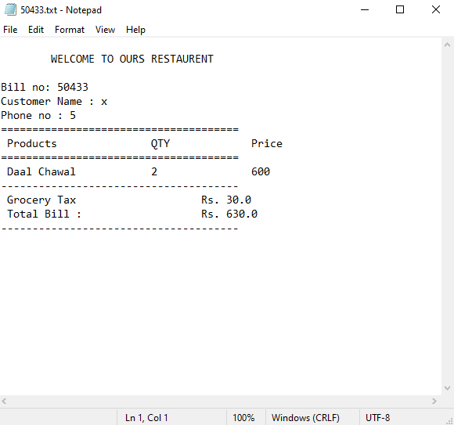
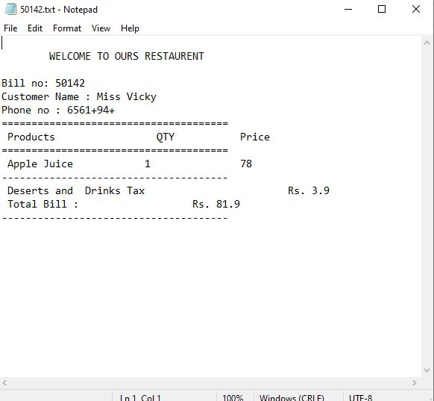
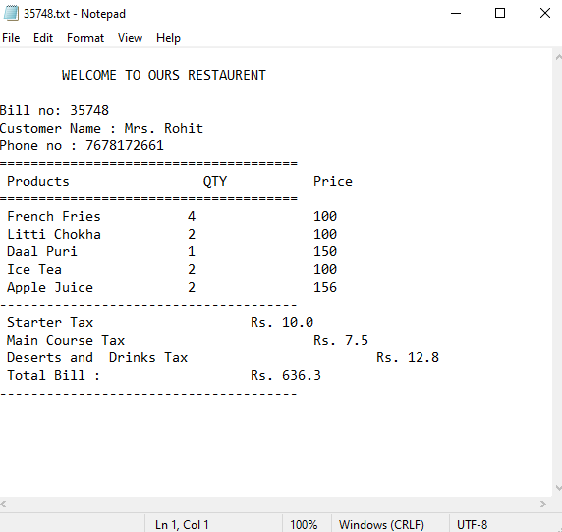
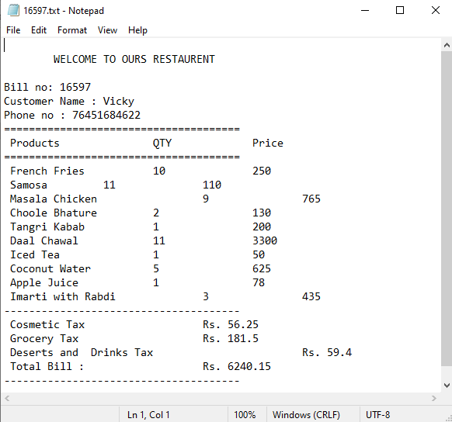
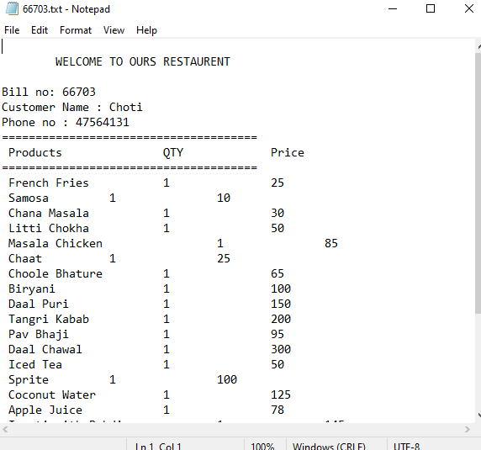
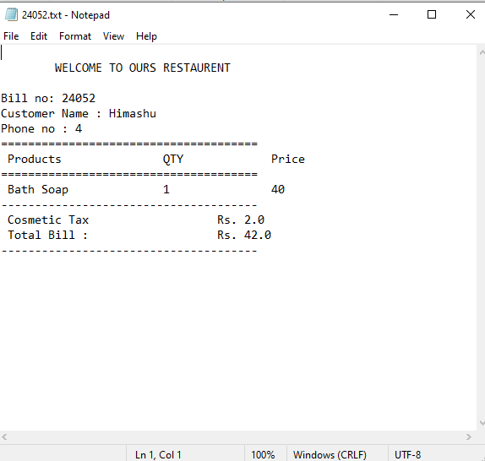
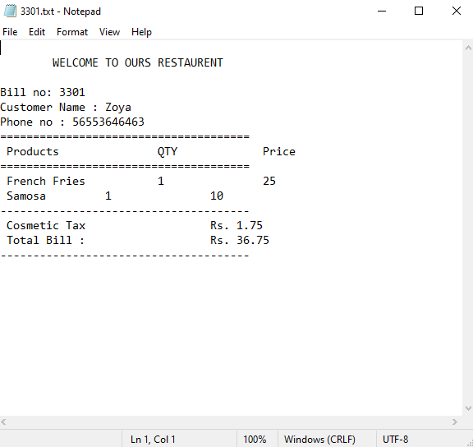
Saved data

Slide 25
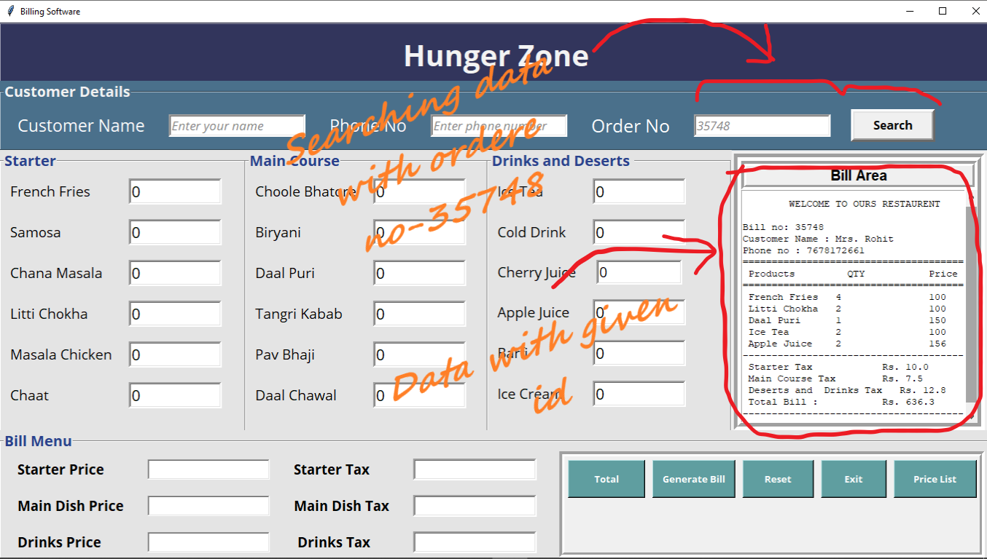
Saved data Accessing data in main window

Slide 26
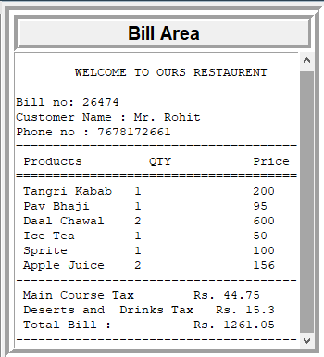
Invoice
Billing Area :
Billing is to have a printed overall order list and their price
Billing includes name, phone number are must
“Bill no” is auto generated unique number

Slide 27
Hardware and Software requirement
Requirement name | Availability
Processor | Core 2 DUAL or more
RAM | 1,2 Gb or more
HDD | 500 GB or more
OS | Window 7 or later
Database | “.txt” or any text editor

Slide 28
Conclusion(1)
We have a system which takes the necessary choice of the customer according to the filter like category of the food. This is achieved through an easy to use graphical interface menu options. The users can add any number of items to the cart from any of the available food categories.
Customer according to the choice payment is done. And the customer gets a bill generated on a hard copy.
Using this software users saves their time by faster ordering, and this software saves the extra effort of the man. And hence all this saves the capital of the owner of the restaurant.

Slide 29
Conclusion(2)
Project is mainly implemented in restaurants and dhabas. I take this opportunity to all those who helped me in completing this project and implementation.
I’m immensely grateful to my esteemed project guide Mr. H.S. Bhatia (Head of Department of Computer Engg.) guidance, without which this work would not have been possible.
This project and implementation has contributed a lot to my knowledge that has proved to be a value addition for me.

Slide 30
Thankyou Everyone

Slide 31
Project by - Rohit Kumar Mahato
Roll no - 1702051050
Project to - Mr. H.S. Bhatia

